Slide 1







CHUYÊN ĐỀ ĐỔI MỚI
KIỂM TRA ĐÁNH GIÁ
VỀ KỸ NĂNG ĐỌC HIỂU
CỦA HỌC SINH KHỐI 9
Người thực hiện:
Bạch Thị Ngọc Thanh Loan
Huỳnh Thị Bảo Trang

Slide 2


Slide 3
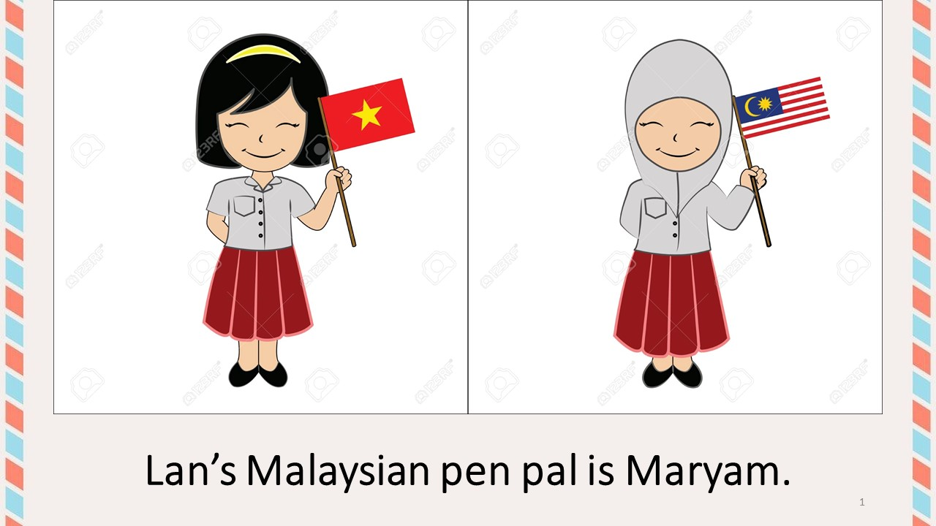

Slide 4


Slide 5
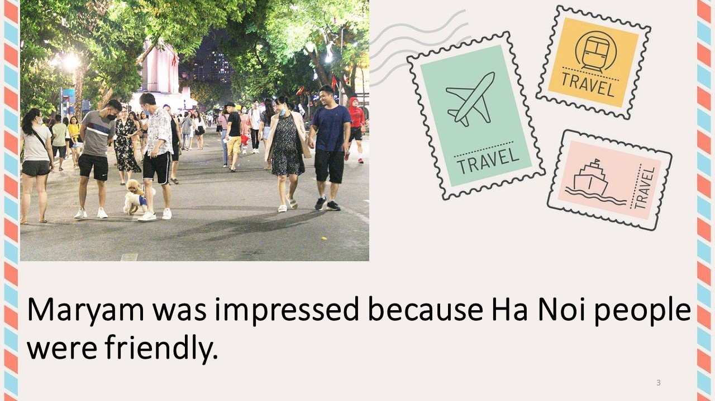

Slide 6
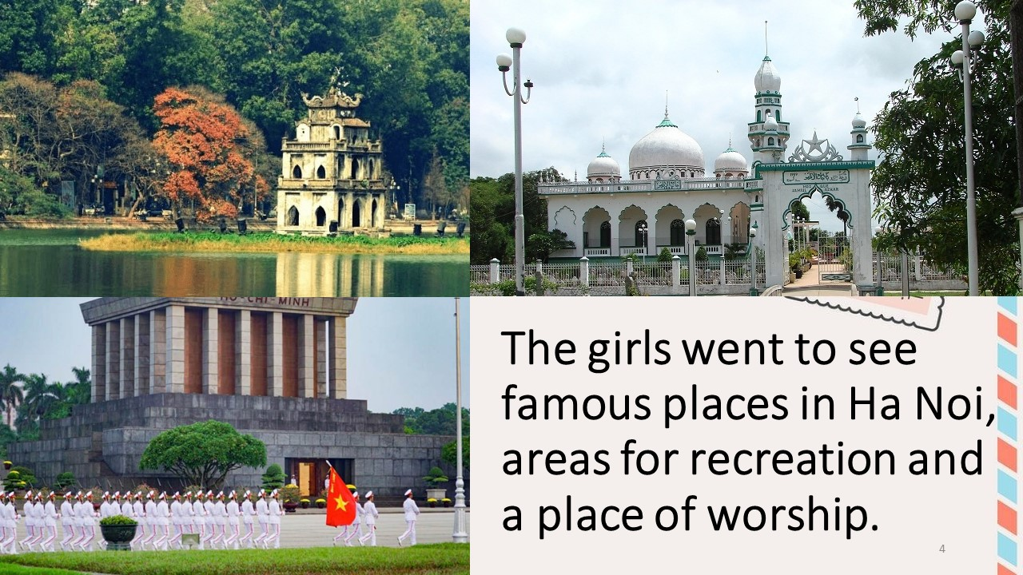

Slide 7


Slide 8
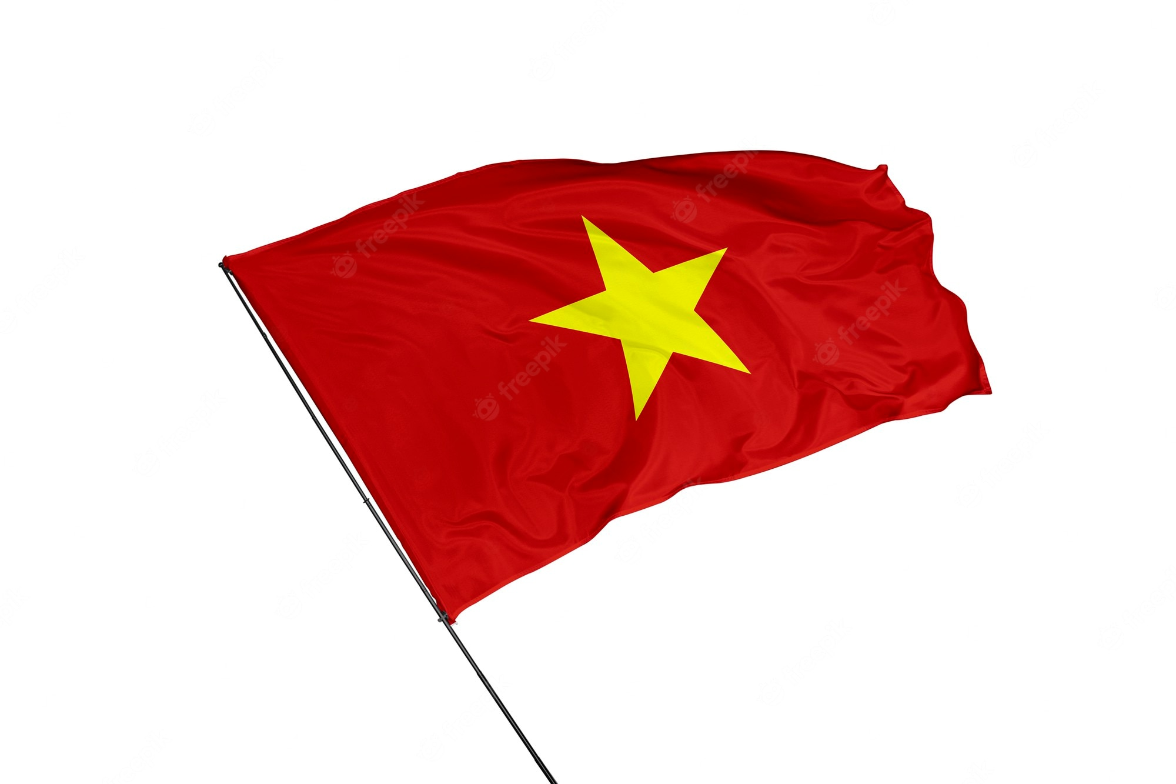
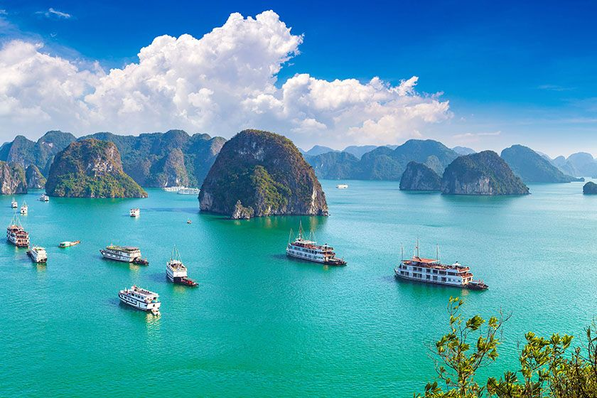
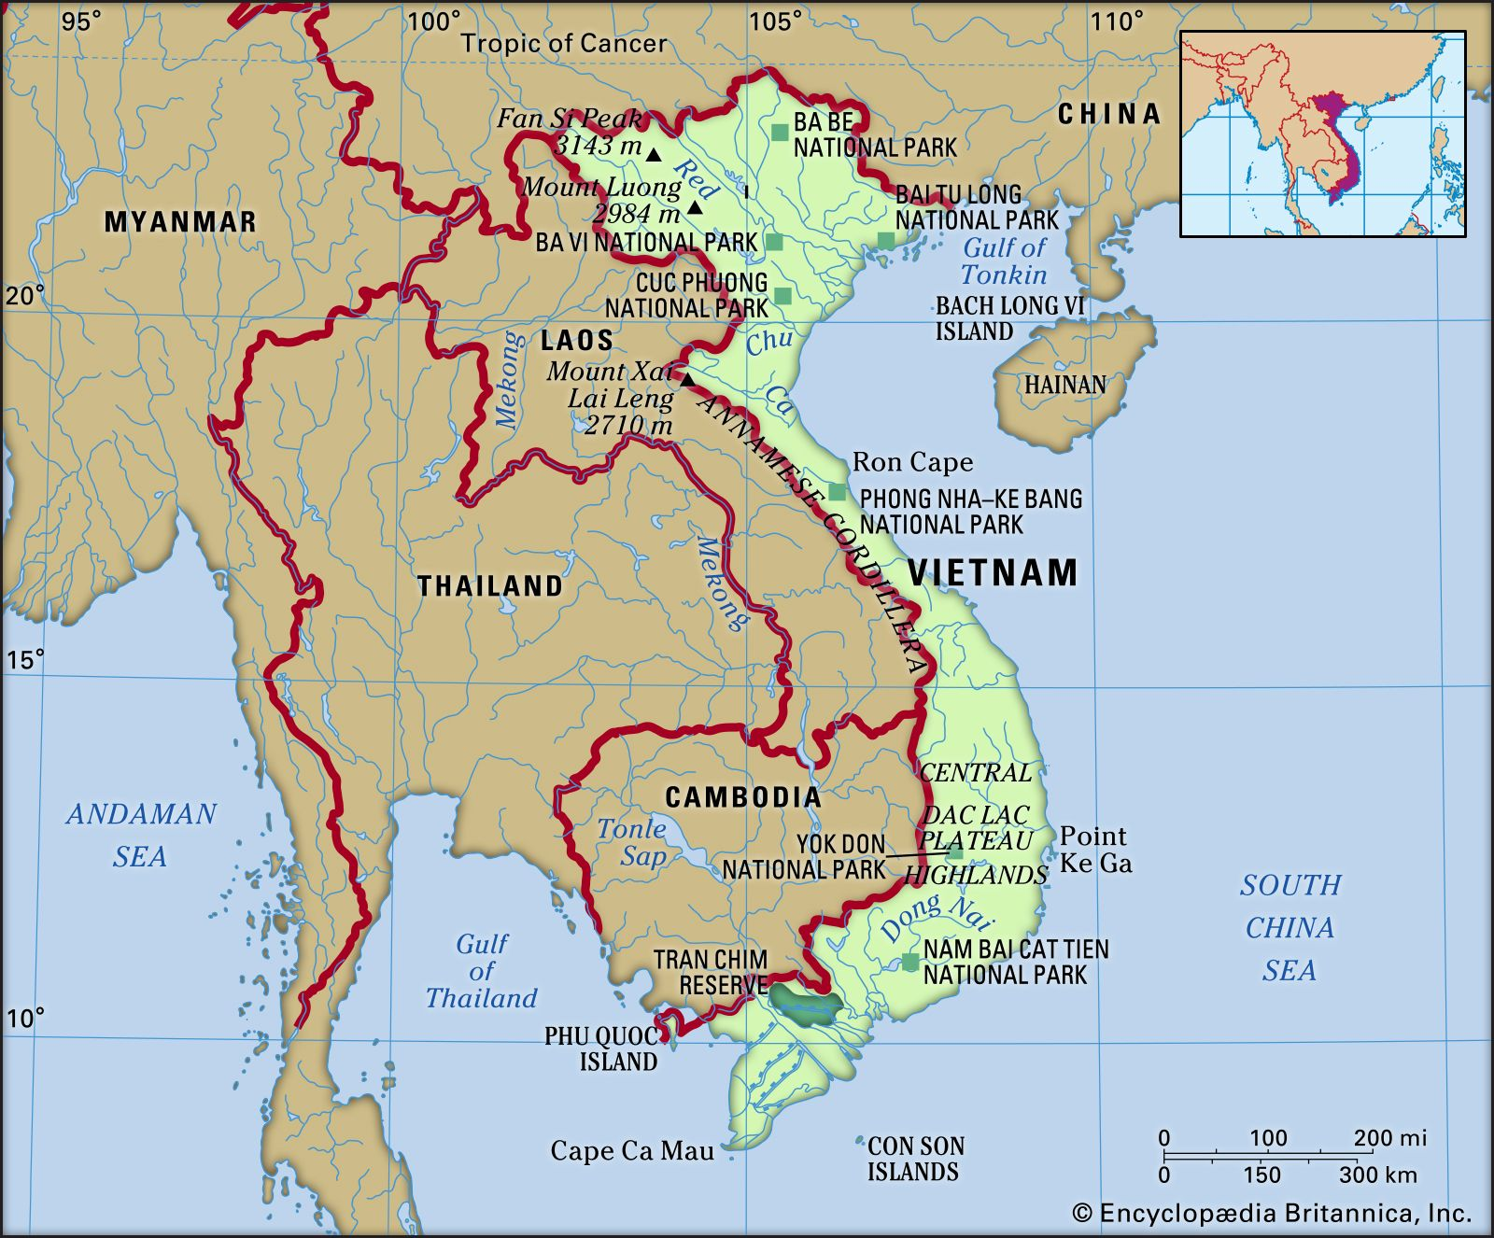
Lan is from Vietnam.

Slide 9

Where is Maryam from?

Slide 10







Read (page 9-10)
Malaysia is one of the countries of the Association of South East Asian Nations (ASEAN). It is divided into two regions, known as West Malaysia and East Malaysia. They are separated by about 640 kilometers of the sea and together comprise an area of 329,758 sq km. Malaysia enjoys tropical climate. The Malaysian unit of currency is the ringgit, consisting of 100 sens.
The capital of Malaysia is Kuala Lumpur and it is also the largest city in the country. The population in 2001 was over 22 million. Islam is the country’s official religion. In addition, there are other religions such as Buddhism and Hinduism. The national language is Bahasa Malaysia (also known simply as Malay). English, Chinese, and Tamil are also widely spoken. The language of instruction for primary school children is Bahasa Malaysia, Chinese, or Tamil. Bahasa Malaysia is the primary language of instruction in all secondary schools, although some students may continue learning in Chinese or Tamil. And English is a compulsory second language.

Slide 11


Fill in the table with the right information about Malaysia
a
1.Area:
2.Population:
3.Climate:
4.Unit of currency:
5.Capital city:
6.Official religion:
7.National language:
8.Compulsory second language:
329,758 sq km
over 22 million in 2001
tropical climate
the ringgit
Kuala Lumpur
Islam
Bahasa Malaysia
English

Slide 12





TRUE OR FALSE? CHECK THE BOXES, THEN CORRECT THE FALSE STATEMENT
1. Malaysia is a member country of ASEAN.
T
2. There are two religions in Malaysia.
F
(There are more than two religions.)
3. People speak only Malay in Malaysia.
F
(English, Chinese, and Tamil are also widely spoken.)
4. Primary school children learn three
languages at school.
F
(One of the three: Malay, Chinese, Tamil.)
5. All secondary school children learn in
English.
F
(English is a compulsory second language,
not primary language of instruction.)

Slide 13



Slide 14


Slide 15
Thailand, one of the countries of Asean is divided into four natural regions: the North, Northeast, the central Plain and the South. Thailand enjoys a warm and (1)_________ climate. Its basic unit of (2)_________ is baht. Bangkok is its capital . The country’s official (3)_____________ is Buddhism. In addition, there are other ones such as Islam, Christianity, and Hinduism. The (4) ___________ language is Thai. Chinese and Malay (5)_________ also spoken in some areas while local dialects are common in rural communities. English is widely spoken (6)_______ Bangkok and other major metropolitan areas.

Slide 16


Slide 17
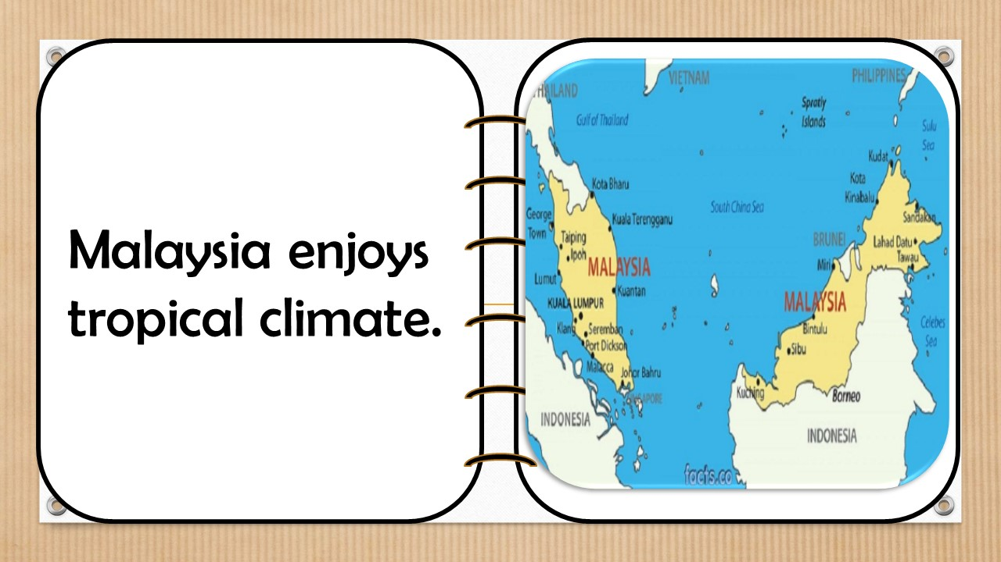

Slide 18
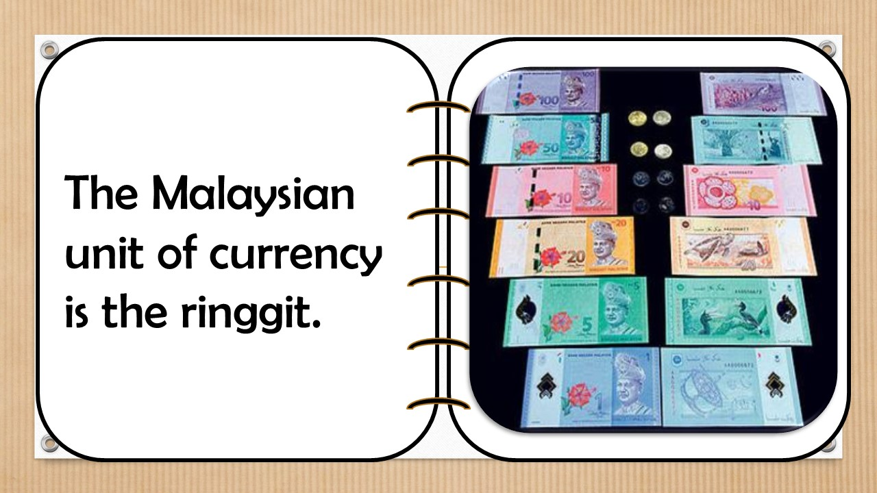

Slide 19
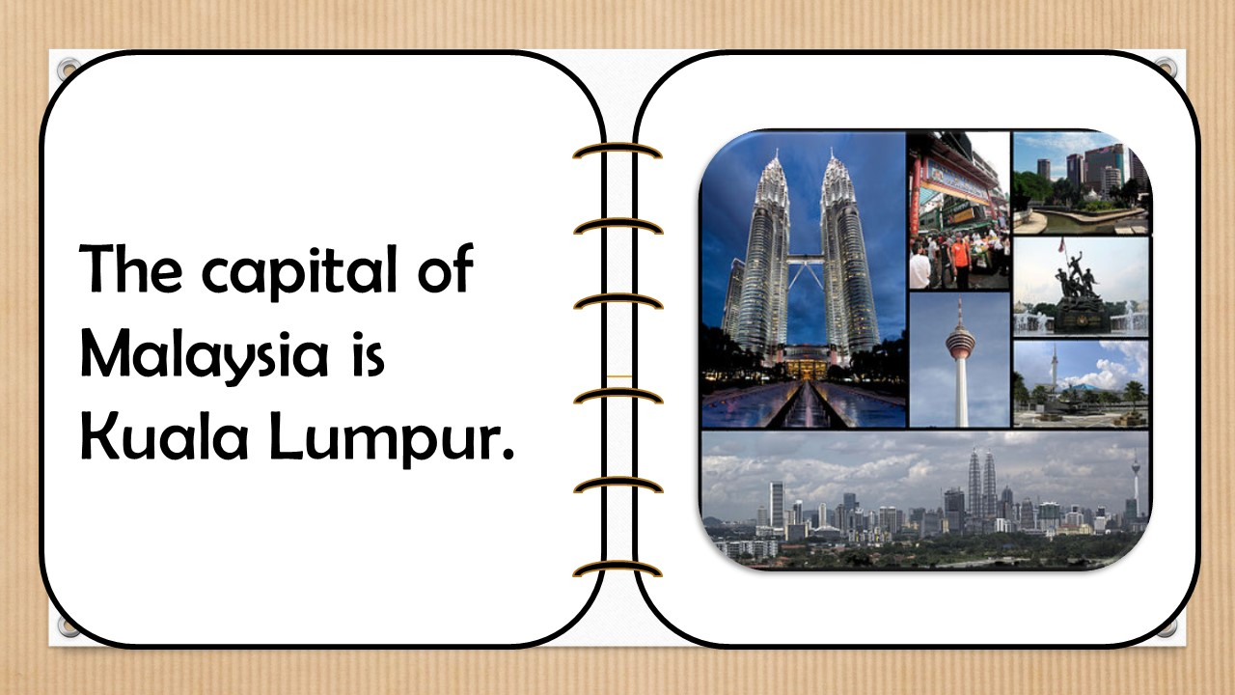

Slide 20
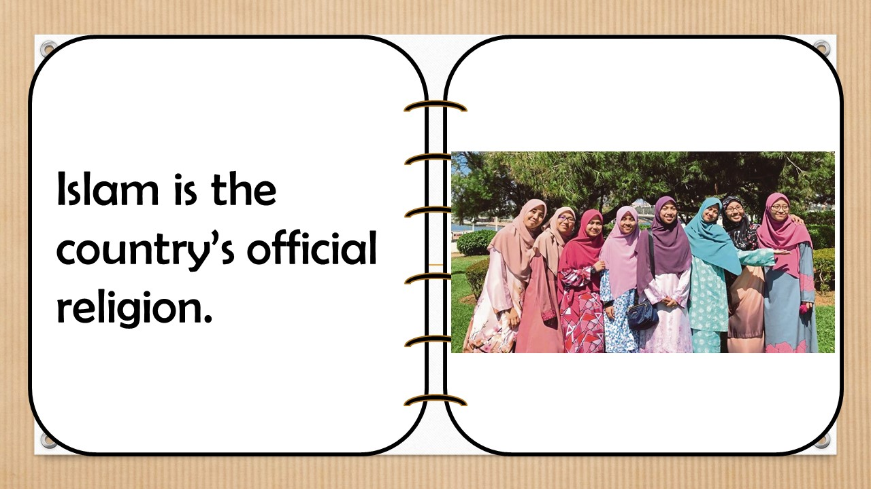

Slide 21
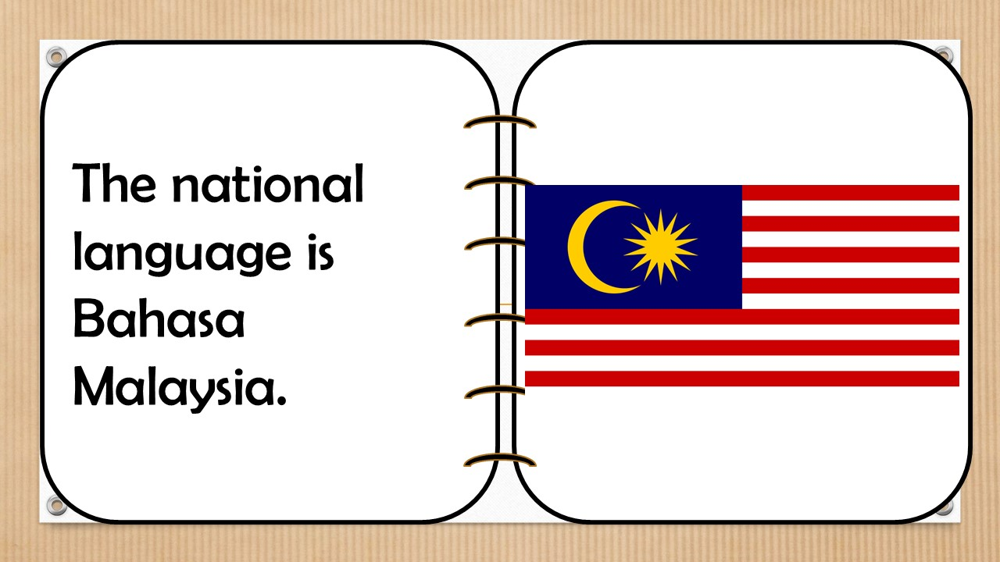

Slide 22


HOMEWORK
Learn new words by heart.
Read the text again.
Prepare next lesson: Language focus.

